Slide 1
Distributed Databases & Distributed Transactions

Slide 2
Distributed Database System
A distributed database system consists of loosely coupled sites that share no physical component
In a homogeneous distributed database
  All sites have identical software
  Are aware of each other and cooperate in processing user requests.
  Appears to user as a single system
In a heterogeneous distributed database
  Different sites may use different schemas and software
    Difference in schema is a major problem for query processing
    Difference in software is a major problem for transaction processing
  Sites may not be aware of each other and may provide only
  limited facilities for cooperation in transaction processing
Transactions may access data at one or more sites

Slide 3
Distributed Data Storage
Assume relational data model
Replication
  System maintains multiple copies of data, stored in different sites, for faster retrieval and fault tolerance.
Fragmentation
  Relation is partitioned into several fragments stored in distinct sites
Replication and fragmentation can be combined
  Relation is partitioned into several fragments: system maintains several identical replicas of each such fragment.

Slide 4
Data Replication
Advantages of Replication
  Availability: failure of site containing relation r does not result in unavailability of r is replicas exist.
  Parallelism: queries on r may be processed by several nodes in parallel.
  Reduced data transfer: relation r is available locally at each site containing a replica of r.
Disadvantages of Replication
  Increased cost of updates: each replica of relation r must be updated.
  Increased complexity of concurrency control: concurrent updates to distinct replicas may lead to inconsistent data unless special concurrency control mechanisms are implemented.

Slide 5
Data Fragmentation
Division of relation r into fragments r₁, r₂, …, r_{n} which contain sufficient information to reconstruct relation r.
Horizontal fragmentation: each tuple of r is assigned to one or more fragments
Vertical fragmentation: the schema for relation r is split into several smaller schemas
  All schemas must contain a common candidate key (or superkey) to ensure lossless join property.

Slide 6
Horizontal Fragmentation of account Relation
branch_name
account_number
balance
Hillside
Hillside
Hillside
A-305
A-226
A-155
500
336
62
account₁ = σ_{branch_name=“Hillside”} (account )
branch_name
account_number
balance
Valleyview
Valleyview
Valleyview
Valleyview
A-177
A-402
A-408
A-639
205
10000
1123
750
account₂ = σ_{branch_name=“Valleyview”} (account )

Slide 7
Vertical Fragmentation of employee_info Relation
branch_name
customer_name
tuple_id
Hillside
Hillside
Valleyview
Valleyview
Hillside
Valleyview
Valleyview
Lowman
Camp
Camp
Kahn
Kahn
Kahn
Green
1
2
3
4
5
6
7
deposit₁ = Πbranch_name, customer_name, tuple_id (employee_info )
account_number
balance
tuple_id
A-305
A-226
A-177
A-402
A-155
A-408
A-639
500
336
205
10000
62
1123
750
1
2
3
4
5
6
7
deposit₂ = Πaccount_number, balance, tuple_id (employee_info )

Slide 8
Advantages of Fragmentation
Horizontal:
  allows parallel processing on fragments of a relation
  allows a relation to be split so that tuples are located where they are most frequently accessed
Vertical:
  allows tuples to be split so that each part of the tuple is stored where it is most frequently accessed
  allows parallel processing on a relation
Vertical and horizontal fragmentation can be mixed.
  Fragments may be successively fragmented to an arbitrary depth.

Slide 9
Distributed Transaction
A distributed transaction accesses resource managers distributed across a network
When resource managers are DBMSs we refer to the system as a distributed database system
DBMS at Site 1
Application Program
DBMS at Site 2

Slide 10
What is a Distributed Transaction?
Data
Data
Transaction
component
Transaction
component
Transaction
component
Transaction
component
Data
Data

Slide 11
Why are Distributed Transactions Hard?
Atomic
  Different parts of a transaction may be at different sites
  How do we ensure all or none committed?
Consistent
  Failure may affect only part of transaction
Isolated
  Commitment must occur “simultaneously” at all sites
Durable
  Not much different when other problems solved

Slide 12
Key Issues
Commit
  Distributed systems need commit protocols so we know when commit has occurred
Failures
  What happens if a site fails during commit?

Slide 13
ACID Properties
Operations at each site are grouped together as a subtransaction
Each local DBMS:
  Supports ACID locally for each subtransaction
    Just like any other transaction that executes there
  Eliminates local deadlocks.
The additional issues are:
  Global atomicity: all cohorts must abort or all commit
  Global deadlocks: there must be no deadlocks involving multiple sites
  Global serialization: distributed transaction must be globally serializable

Slide 14
Distributed Transactions
Transaction may access data at several sites.
Each site has a local transaction manager responsible for:
  Maintaining a log for recovery purposes
  Participating in coordinating the concurrent execution of the transactions executing at that site.
Each site has a transaction coordinator, which is responsible for:
  Starting the execution of transactions that originate at the site.
  Distributing subtransactions at appropriate sites for execution.
  Coordinating the termination of each transaction that originates at the site, which may result in the transaction being committed at all sites or aborted at all sites.

Slide 15
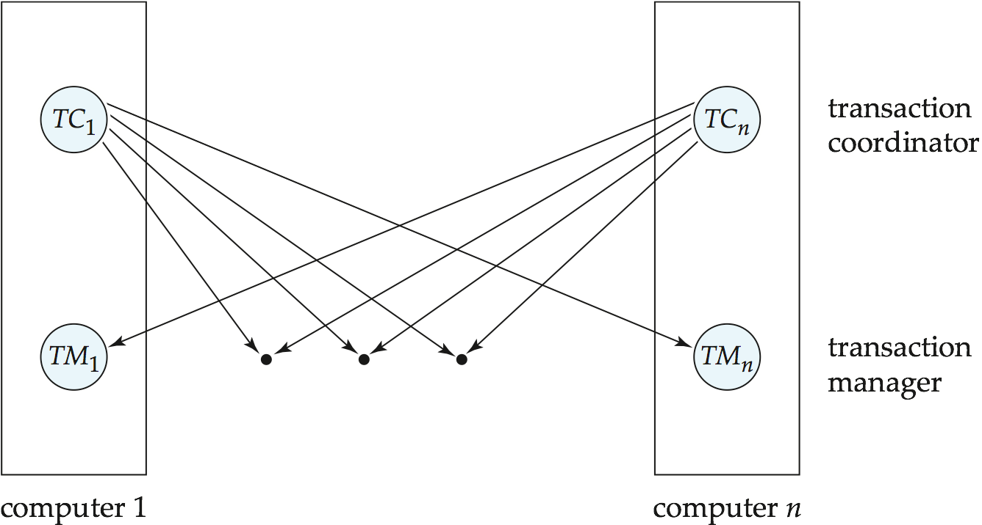
Transaction System Architecture

Slide 16
Commit Protocols
Commit protocols are used to ensure atomicity across sites
  a transaction which executes at multiple sites must either be committed at all the sites, or aborted at all the sites.
  not acceptable to have a transaction committed at one site and aborted at another
The two-phase commit (2PC) protocol is widely used
The three-phase commit (3PC) protocol is more complicated and more expensive, but avoids some drawbacks of two-phase commit protocol. This protocol is not used in practice.

Slide 17
Two Phase Commit Protocol (2PC)
Assumes fail-stop model – failed sites simply stop working, and do not cause any other harm, such as sending incorrect messages to other sites.
Execution of the protocol is initiated by the coordinator after the last step of the transaction has been reached.
The protocol involves all the local sites at which the transaction executed
Let T be a transaction initiated at site S_{i}, and let the transaction coordinator at S_{i} be C_{i}

Slide 18
Phase 1: Obtaining a Decision
Coordinator asks all participants to prepare to commit transaction T_{i}.
  C_{i} adds the records <prepare T> to the log and forces log to stable storage
  sends prepare T messages to all sites at which T executed
Upon receiving message, transaction manager at site determines if it can commit the transaction
  if not, add a record <no T> to the log and send abort T message to C_{i}
  if the transaction can be committed, then:
  add the record <ready T> to the log
  force all records for T to stable storage
  send ready T message to C_{i}

Slide 19
Phase 2: Recording the Decision
T can be committed of C_{i} received a ready T message from all the participating sites: otherwise T must be aborted.
Coordinator adds a decision record, <commit T> or <abort T>, to the log and forces record onto stable storage. Once the record stable storage it is irrevocable (even if failures occur)
Coordinator sends a message to each participant informing it of the decision (commit or abort)
Participants take appropriate action locally.

Slide 20
Handling of Failures - Site Failure
When site S_{i} recovers, it examines its log to determine the fate of transactions active at the time of the failure.
Log contain <commit T> record: txn had completed, nothing to be done
Log contains <abort T> record: txn had completed, nothing to be done
Log contains <ready T> record: site must consult C_{i} to determine the fate of T.
  If T committed, redo (T); write <commit T> record
  If T aborted, undo (T)
The log contains no log records concerning T:
  Implies that S_{i} failed before responding to the prepare T message from C_{i}
  since the failure of S_{i} precludes the sending of such a response, coordinator C₁ must abort T
  S_{i} must execute undo (T)

Slide 21
Handling of Failures- Coordinator Failure
If coordinator fails while the commit protocol for T is executing then participating sites must decide on T’s fate:
  If an active site contains a <commit T> record in its log, then T must be committed.
  If an active site contains an <abort T> record in its log, then T must be aborted.
  If some active participating site does not contain a <ready T> record in its log, then the failed coordinator C_{i} cannot have decided to commit T.
    Can therefore abort T; however, such a site must reject any subsequent <prepare T> message from C_{i}
  If none of the above cases holds, then all active sites must have a <ready T> record in their logs, but no additional control records (such as <abort T> of <commit T>).
    In this case active sites must wait for C_{i} to recover, to find decision.
Blocking problem: active sites may have to wait for failed coordinator to recover.

Slide 22
Concurrency Control

Slide 23
Concurrency Control
Modify concurrency control schemes for use in distributed environment.
We assume that each site participates in the execution of a commit protocol to ensure global transaction atomicity.
We assume all replicas of any item are updated

Slide 24
Single-Lock-Manager Approach
System maintains a single lock manager that resides in a single chosen site, say S_{i}
When a transaction needs to lock a data item, it sends a lock request to S_{i} and lock manager determines whether the lock can be granted immediately
  If yes, lock manager sends a message to the site which initiated the request
  If no, request is delayed until it can be granted, at which time a message is sent to the initiating site

Slide 25
Single-Lock-Manager Approach (Cont.)
The transaction can read the data item from any one of the sites at which a replica of the data item resides.
Writes must be performed on all replicas of a data item
Advantages of scheme:
  Simple implementation
  Simple deadlock handling
Disadvantages of scheme are:
  Bottleneck: lock manager site becomes a bottleneck
  Vulnerability: system is vulnerable to lock manager site failure.

Slide 26
Distributed Lock Manager
In this approach, functionality of locking is implemented by lock managers at each site
Several variants of this approach
  Primary copy
  Majority protocol
  Biased protocol
  Quorum consensus

Slide 27
Primary Copy
Choose one replica of data item to be the primary copy.
  Site containing the replica is called the primary site for that data item
  Different data items can have different primary sites
When a transaction needs to lock a data item Q, it requests a lock at the primary site of Q.
  Implicitly gets lock on all replicas of the data item
Benefit
  Concurrency control for replicated data handled similarly to unreplicated data - simple implementation.
Drawback
  If the primary site of Q fails, Q is inaccessible even though other sites containing a replica may be accessible.

Slide 28
Majority Protocol
Local lock manager at each site administers lock and unlock requests for data items stored at that site.
When a transaction wishes to lock an unreplicated data item Q residing at site S_{i}, a message is sent to S_{i} ‘s lock manager.
  If Q is locked in an incompatible mode, then the request is delayed until it can be granted.
  When the lock request can be granted, the lock manager sends a message back to the initiator indicating that the lock request has been granted.

Slide 29
Majority Protocol (Cont.)
In case of replicated data
  If Q is replicated at n sites, then a lock request message must be sent to more than half of the n sites in which Q is stored.
  The transaction does not operate on Q until it has obtained a lock on a majority of the replicas of Q.
  When writing the data item, transaction performs writes on all replicas.
Benefit
  Can be used even when some sites are unavailable
Drawback
  Requires 2(n/2 + 1) messages for handling lock requests, and (n/2 + 1) messages for handling unlock requests.
  Potential for deadlock even with single item - e.g., each of 3 transactions may have locks on 1/3rd of the replicas of a data.

Slide 30
Biased Protocol
Local lock manager at each site as in majority protocol, however, requests for shared locks are handled differently than requests for exclusive locks.
Shared locks. When a transaction needs to lock data item Q, it simply requests a lock on Q from the lock manager at one site containing a replica of Q.
Exclusive locks. When transaction needs to lock data item Q, it requests a lock on Q from the lock manager at all sites containing a replica of Q.
Advantage - imposes less overhead on read operations.
Disadvantage - additional overhead on writes

Slide 31
Quorum Consensus Replica Control
Replica control dynamically selects and locks a read (write) quorum of replicas when a read (or write) request is made
  Read operation reads only replicas in the read quorum
  Write operation writes only replicas in the write quorum
  If p = |read quorum|, q = |write quorum| and n = |replica set| then algorithm decides that if:
  p+q > n
(read/write conflict)
  q > n/2
(write/write conflict)
Guarantees that all conflicts between operations of concurrent transactions will be detected at some site and one transaction will be forced to wait.
  Serializability is maintained

Slide 32
Quorum Consensus Replica Control
write
quorum (q)
Set of all
replicas of
an item (n)
read
quorum (p)
Read/write conflict: p + q > n
An intersection between any read and any write quorum

Slide 33
Timestamping
Timestamp based concurrency-control protocols can be used in distributed systems
Each transaction must be given a unique timestamp
Main problem: how to generate a timestamp in a distributed fashion
  Each site generates a unique local timestamp using either a logical counter or the local clock.
  Global unique timestamp is obtained by concatenating the unique local timestamp with the unique identifier.

Slide 34
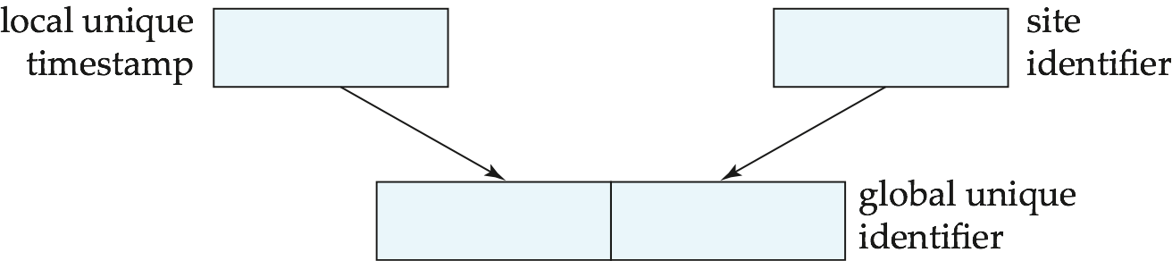

Slide 35
Timestamping (Cont.)
A site with a slow clock will assign smaller timestamps
  Still logically correct: serializability not affected
  But: “disadvantages” transactions
To fix this problem, synchronize clocks
  Define within each site S_{i} a logical clock (LC_{i}), which generates the unique local timestamp
  Require that S_{i} advance its logical clock whenever a request is received from a transaction with timestamp < x> and x is greater that the current value of LC_{i}.
  In this case, site S_{i} advances its logical clock to the value x + 1.

Slide 36
Timestamp-Based Protocols
Each transaction is issued a timestamp when it enters the system. If an old transaction T_{i} has time-stamp TS(T_{i}), a new transaction T_{j} is assigned time-stamp TS(T_{j}) such that TS(T_{i}) <TS(T_{j}).
The protocol manages concurrent execution such that the time-stamps determine the serializability order.
In order to assure such behavior, the protocol maintains for each data Q two timestamp values:
  W-timestamp(Q) is the largest time-stamp of any transaction that executed write(Q) successfully.
  R-timestamp(Q) is the largest time-stamp of any transaction that executed read(Q) successfully.

Slide 37
Timestamp-Based Protocols (Cont.)
The timestamp ordering protocol ensures that any conflicting read and write operations are executed in timestamp order.
Suppose a transaction T_{i} issues a read(Q)
  If TS(T_{i}) ≤ W-timestamp(Q), then T_{i} needs to read a value of Q that was already overwritten.
    Hence, the read operation is rejected, and T_{i} is rolled back.
  If TS(T_{i}) ≥ W-timestamp(Q), then the read operation is executed, and R-timestamp(Q) is set to max(R-timestamp(Q), TS(T_{i})).

Slide 38
Timestamp-Based Protocols (Cont.)
Suppose that transaction T_{i} issues write(Q).
  If TS(T_{i}) < R-timestamp(Q), then the value of Q that T_{i} is producing was needed previously, and the system assumed that that value would never be produced.
    Hence, the write operation is rejected, and T_{i} is rolled back.
  If TS(T_{i}) < W-timestamp(Q), then T_{i} is attempting to write an obsolete value of Q.
    Hence, this write operation is rejected, and T_{i} is rolled back.
  Otherwise, the write operation is executed, and W-timestamp(Q) is set to TS(T_{i}).

Slide 39
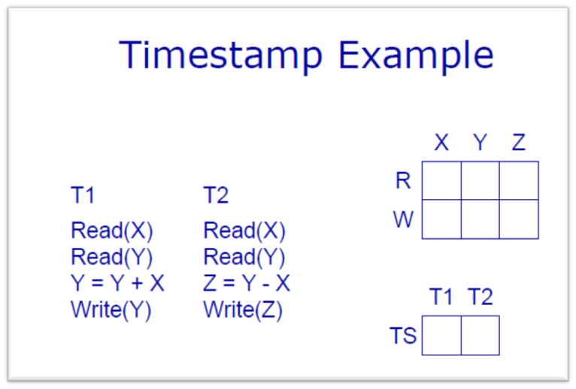
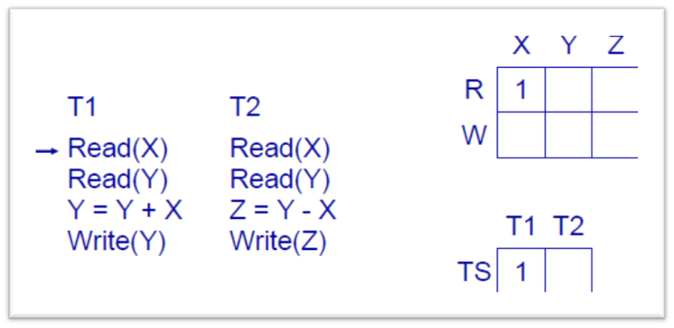
1

Slide 40
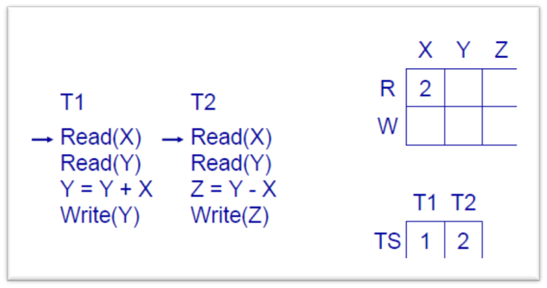
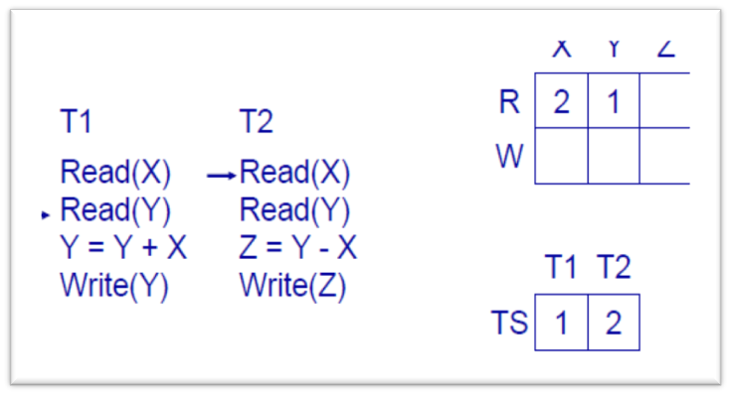
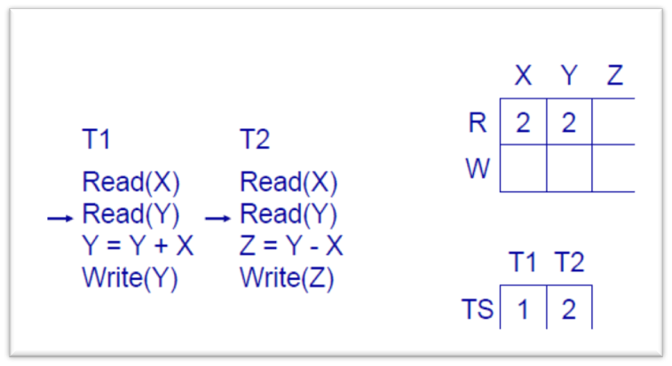
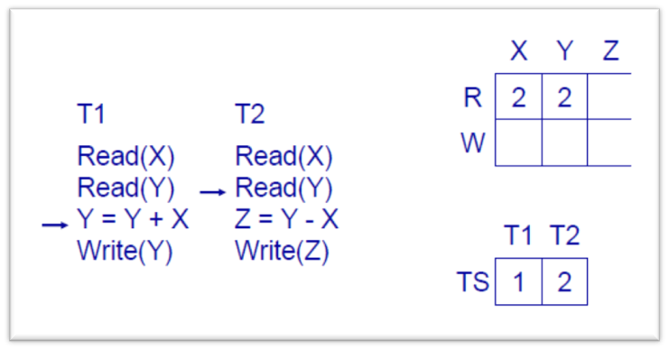
2
3
4
5

Slide 41
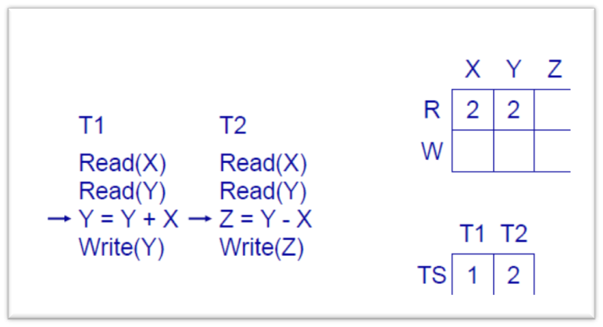
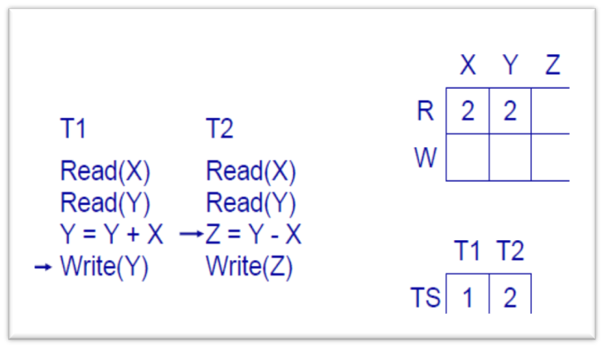
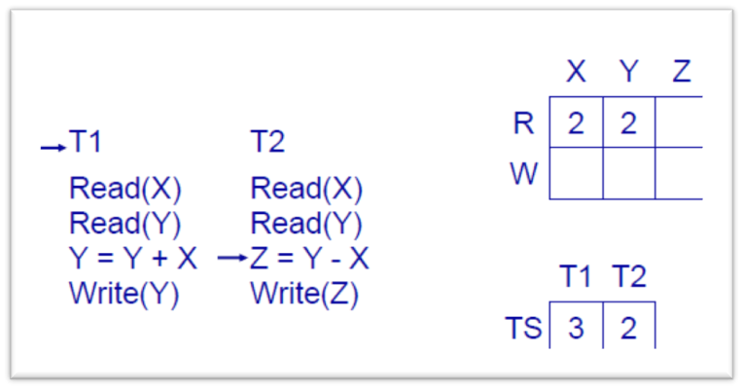
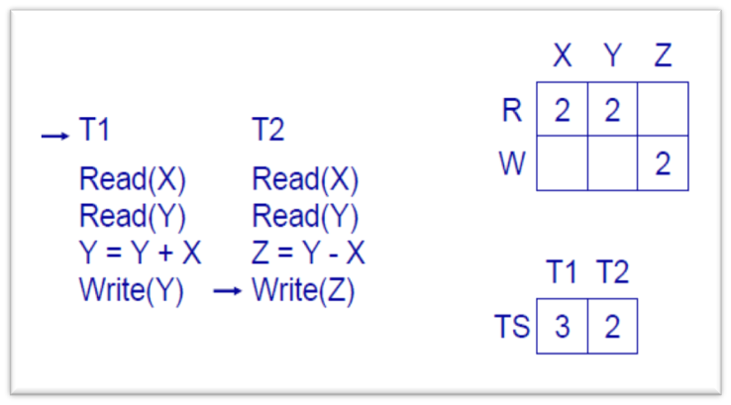
6
7
8
9

Slide 42
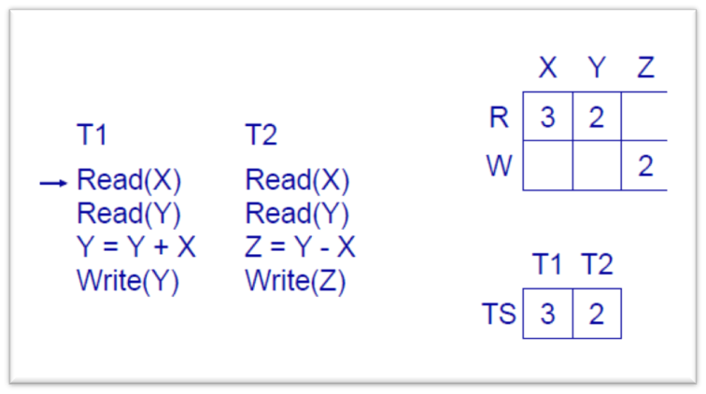
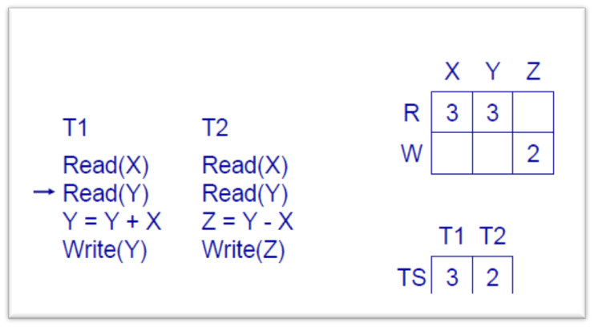
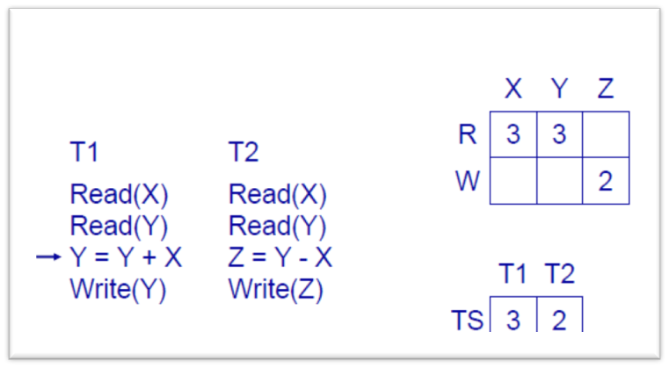
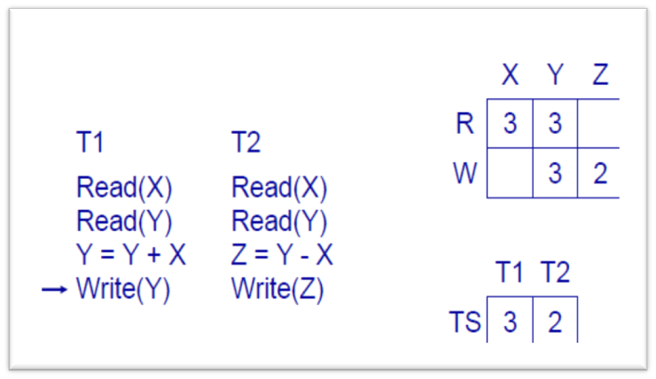
10
11
12
13

Slide 43

Example Use of the Protocol
A partial schedule for several data items for transactions with
timestamps 1, 2, 3, 4, 5

Slide 44

Correctness of Timestamp-Ordering Protocol
The timestamp-ordering protocol guarantees serializability since all the arcs in the precedence graph are of the form:
Thus, there will be no cycles in the precedence graph
Timestamp protocol ensures freedom from deadlock as no transaction ever waits.
But the schedule may not be cascade-free, and may not even be recoverable.

Slide 45
Thomas’ Write Rule
Modified version of the timestamp-ordering protocol in which obsolete write operations may be ignored under certain circumstances.
When T_{i} attempts to write data item Q, if TS(T_{i}) < W-timestamp(Q), then T_{i} is attempting to write an obsolete value of {Q}.
  Rather than rolling back T_{i} as the timestamp ordering protocol would have done, this {write} operation can be ignored.
Otherwise this protocol is the same as the timestamp ordering protocol.
Thomas' Write Rule allows greater potential concurrency.
  Allows some view-serializable schedules that are not conflict-serializable.

